Slide 1
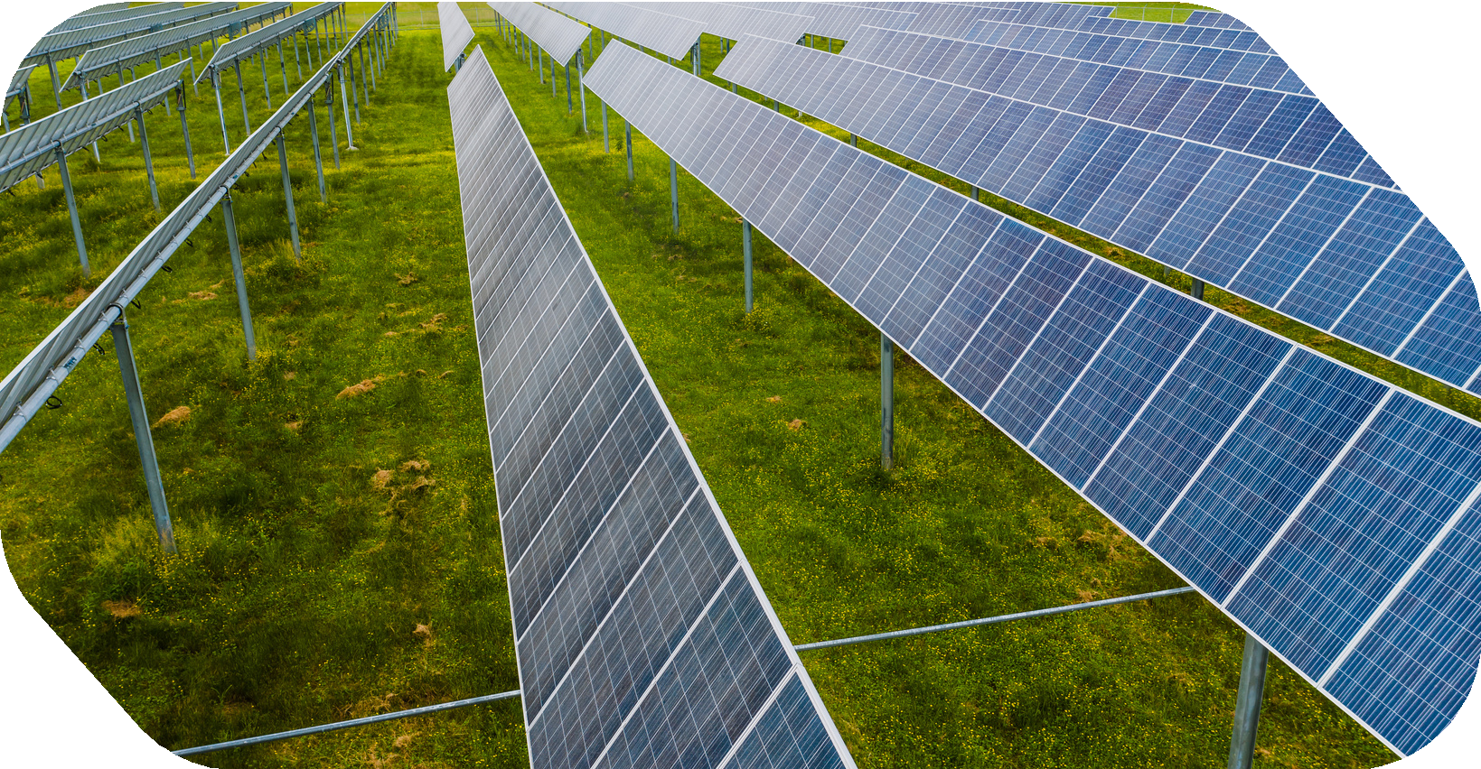


Low Adoption Of Renewable Energy
Presented by:
Levin George Thomas Liana Roby
M Preksha Praveen Maahir Muhammadali Maheswar Prasad Malavika Abhishek

Slide 2
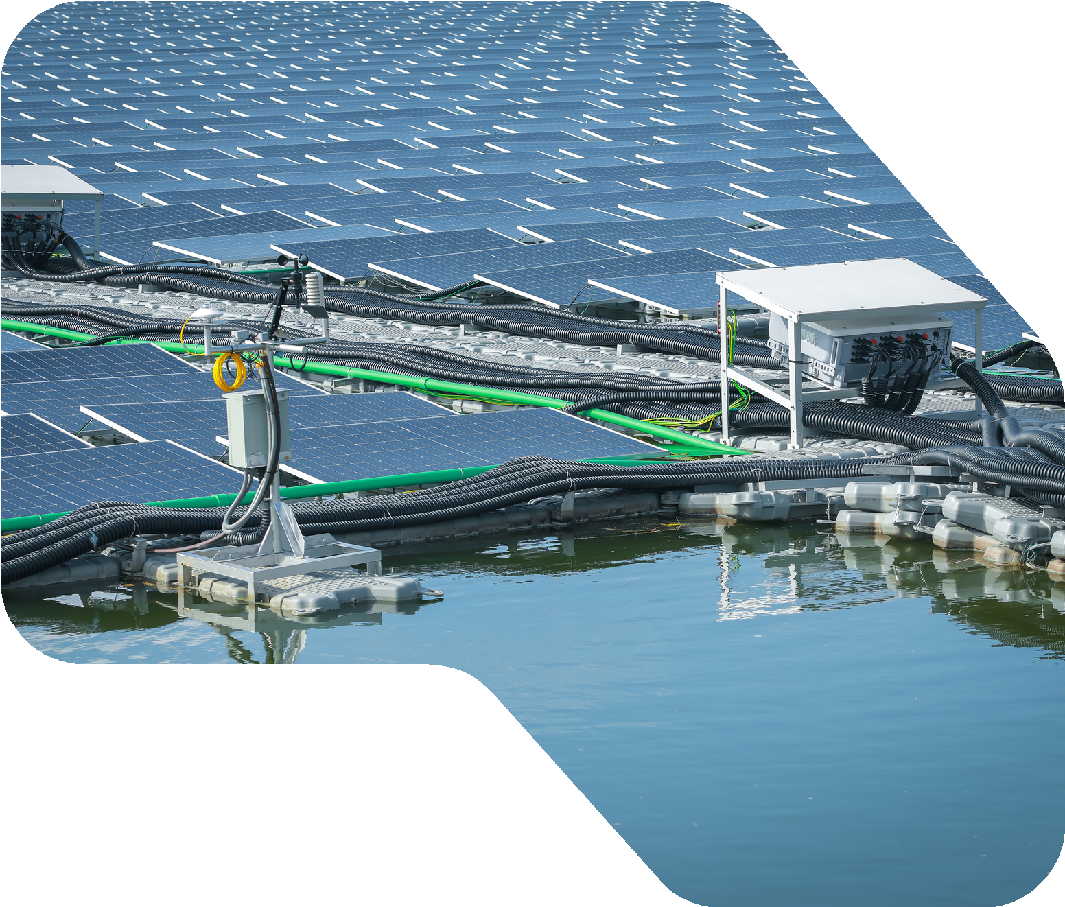

Low Adoption of Renewable Energy
What is it about?
Renewable energy comes from sources that naturally replenish — sunlight, wind, water, geothermal heat and biomass. Unlike coal, oil and gas, they produce little to no greenhouse emissions.
Despite clear benefits, adoption remains low in many regions. High upfront costs, weak infrastructure, policy gaps, and dependence on established fossil-fuel systems slow the transition.
This presentation examines the barriers to renewable energy adoption and why speeding it up matters for a sustainable future.

Slide 3
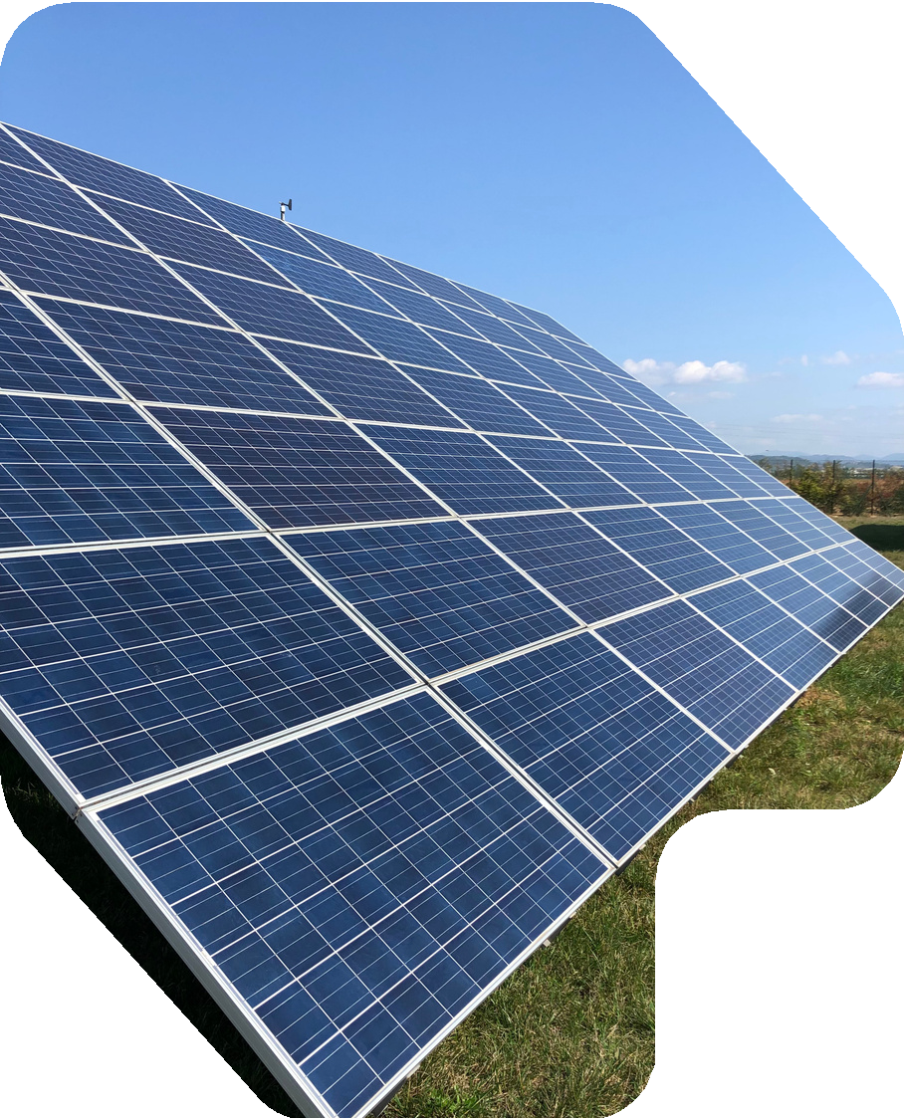
SDG 7 - Affordable and Clean Energy
Why this SDG matters here
SDG 7 aims to ensure access to affordable, reliable, sustainable and modern energy for all by 2030. Low renewable adoption is the core obstacle to reaching it.
Every barrier to clean energy — cost, infrastructure, policy — directly slows progress on this goal, keeping communities dependent on polluting, finite fuels

Slide 4

Solutions
Grid Modernization & Energy Storage
SolarShare - A Community Solar Investment and Virtual Net-Metering Platform
Solar Impact & Rewards Tracker (SIRT) – A Gamified Web Platform for Rooftop Solar Adoption and Savings Tracking
Renewable Energy Suitability & Site Assessment tool
Renewable Energy Adoption Barrier Advisor
AI Powered Community Solar & P2P

Slide 5
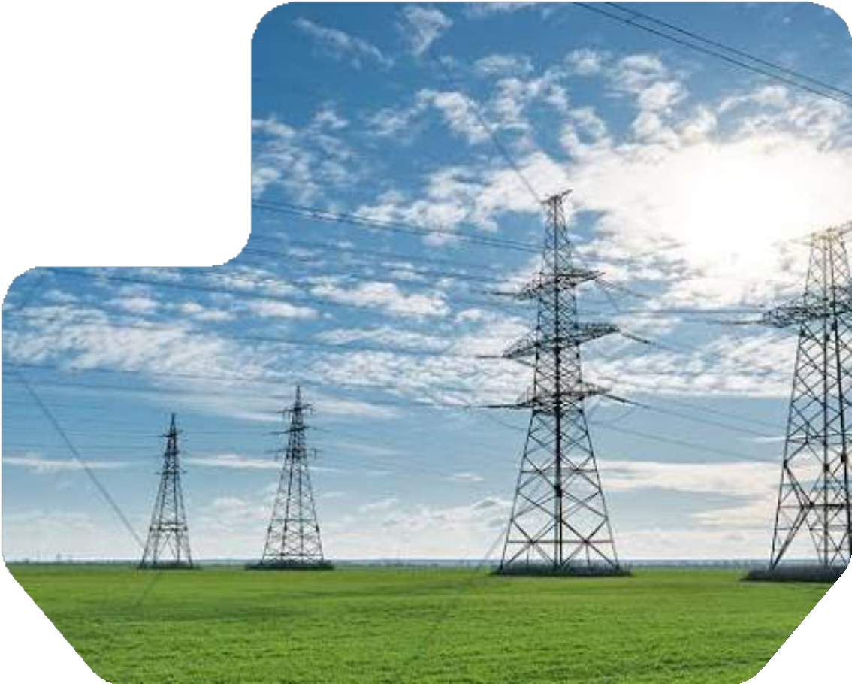
Grid Modernization & Energy Storage
Making the grid ready for clean power
Upgrades ageing grids with smart controls and large-scale battery storage so variable solar and wind supply can be absorbed, balanced and delivered reliably.
Smart grid controls handle fluctuating renewable supply Battery storage shifts surplus energy to peak demand hours Reduces blackouts and curtailment of clean energy

Slide 6
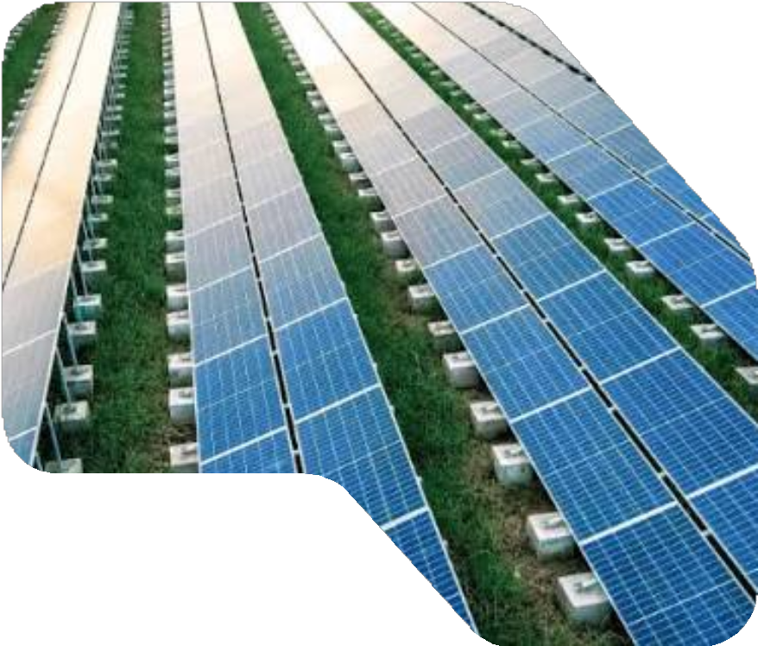
SolarShare - Community Solar Investment Platform
Virtual net-metering for everyone
Lets people who can't install panels buy a share in a shared solar farm and earn bill credits through virtual net-metering — lowering the upfront cost barrier.
Invest in solar without owning a rooftop
Earn credits on electricity bills via virtual net-metering Opens clean energy to renters and apartment dwellers

Slide 7
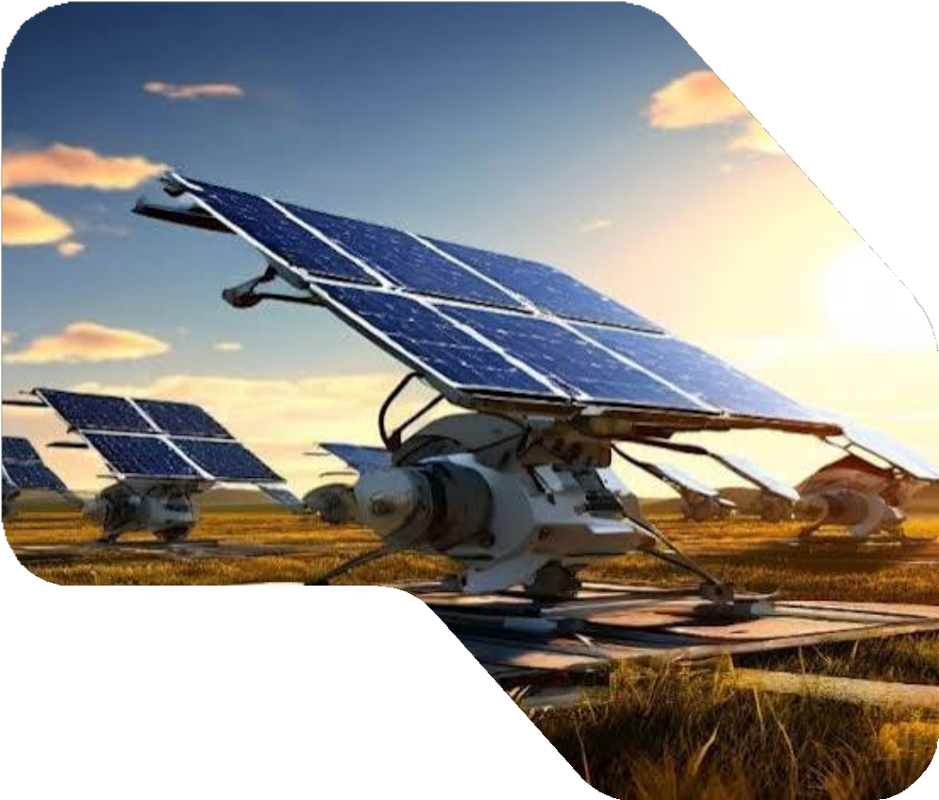
Solar Impact & Rewards Tracker (SIRT)
Gamified rooftop solar adoption
A web platform that turns rooftop solar into a rewarding experience — tracking savings and CO2 impact while using points, badges and leaderboards to drive adoption.
Real-time savings and CO2 impact dashboard Points, badges and leaderboards motivate uptake Turns abstract benefits into visible, shareable wins

Slide 8
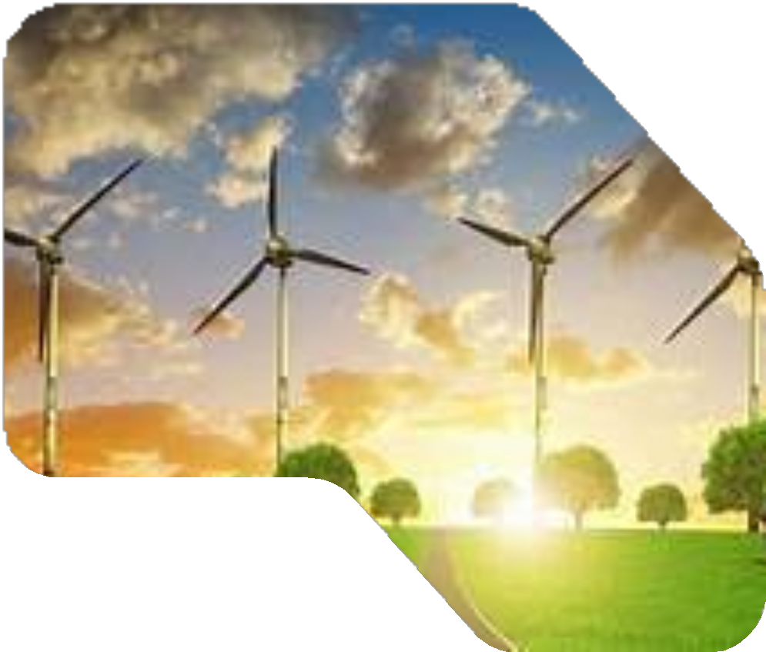
Renewable Energy Suitability & Site Assessment Tool
Know before you install
Assesses a location's solar or wind potential using site data — roof angle, shading, sunlight and space — so users get an accurate feasibility report before investing.
Evaluates solar/wind potential for any site
Factors in shading, orientation and available space Removes guesswork and reduces failed installations

Slide 9
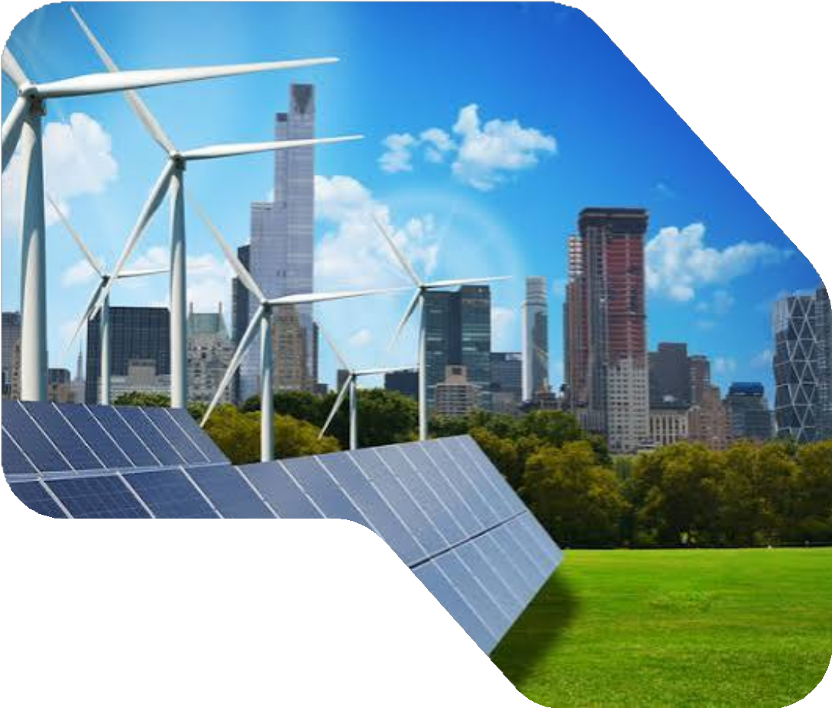
Renewable Energy Adoption Barrier Advisor
Guidance past the roadblocks
An advisory tool that identifies the specific barriers a user faces — cost, policy, awareness — and recommends tailored subsidies, financing and next steps.
Diagnoses each user's adoption barriers Recommends relevant subsidies and financing options Delivers a personalised, actionable roadmap

Slide 10
AI-Powered Community Solar & P2P Energy
Guidance past the roadblocks
An advisory tool that identifies the specific barriers a user faces — cost, policy, awareness — and recommends tailored subsidies, financing and next steps.
Diagnoses each user's adoption barriers Recommends relevant subsidies and financing options Delivers a personalised, actionable roadmap

Slide 11

Why We Chose SolarShare
Of all six solutions, SolarShare removes the single biggest barrier to adoption cost while reaching the widest group of people.
Attacks the #1 barrier It directly targets high upfront cost the main reason people don't go
solar. No panels, wiring or rooftop investment needed.
Scalable & low risk One community farm serves many members, spreading cost and risk while growing clean-energy capacity fast.
Strongest SDG 7 fit
Its whole purpose is affordable, accessible clean energy for all the exact aim of SDG 7.

Slide 12
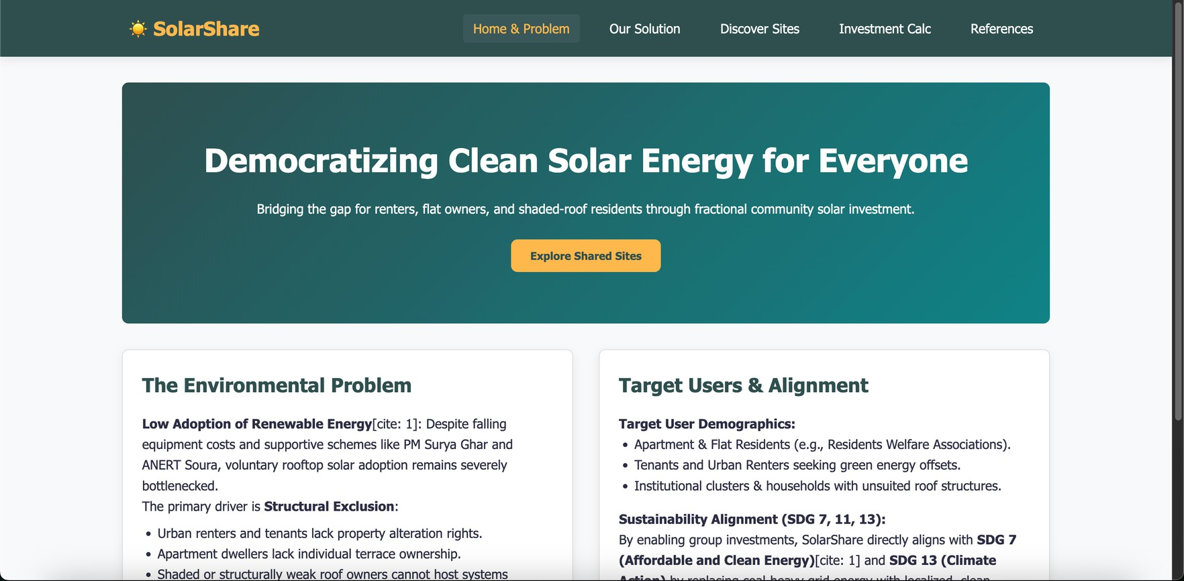
Website Screenshot

Slide 13
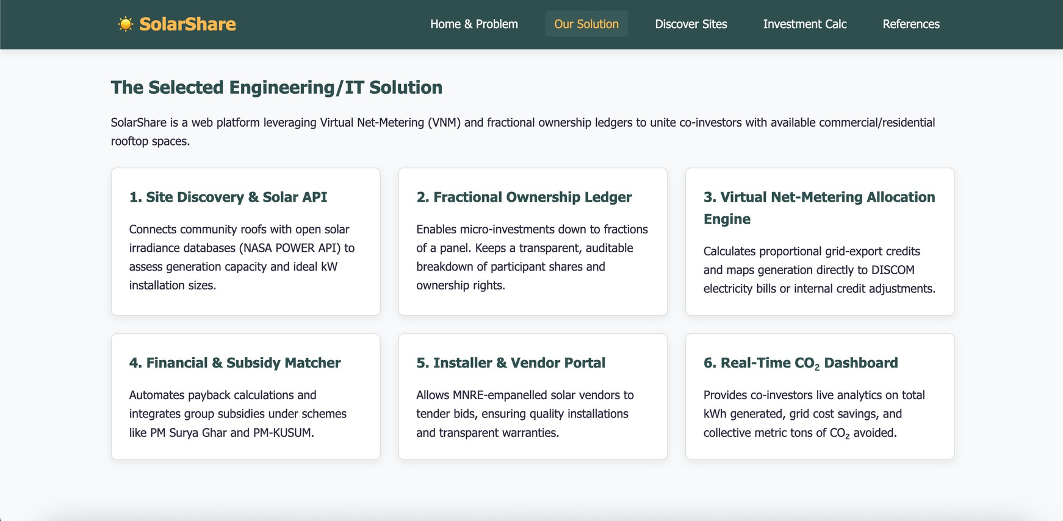
Website Screenshot

Slide 14


Thank You!

